Slide 1


HazCom 2012 Employee Training
Prepared by the Society for Chemical Hazard Communication Outreach and Communication Committee
Intended for Training Public School Employees on the New Hazard Communication

Slide 2
Disclaimer
These materials are provided “as is”. SCHC makes no warranties, expressed or implied, and hereby disclaims and negates all other warranties, including without limitation, implied warranties or conditions of merchantability, fitness for a particular purpose, or non-infringement of intellectual property or other violation of rights. Further, SCHC does not warrant or make any representations concerning the accuracy, likely results, or reliability of the use of these materials. Through the OSHA and SCHC Alliance, SCHC developed this presentation for informational purposes only. It does not necessarily reflect the views of OSHA or the U.S. Department of Labor.

Slide 3

Hazard Communication
( HAZCOM 2012 –
29CFR 1910.1200) and the Globally Harmonized System of Classification and Labeling of Chemicals (GHS)
Notes:
OSHA has revised its Hazard Communication Standard to align with the Globally Harmonized System (or GHS) in use in many other Countries around the world. The adoption of this new system of hazard communication has changed the appearance of labels and SDS that are used in the workplace. This training will familiarize you with the new label elements and the new mandatory safety data sheet format. The new standard went into effect on June 1, 2016 for all workplaces.

Slide 4
OSHA Mandate
The Occupational Safety and Health Administration (OSHA) requires employers to provide their employees with a safe and healthy workplace.
  OSHA sets standards for safety, chemical exposure and information on chemical hazards (right-to know).
  OSHA Standards are enforced in the private sector by Federal OSHA in some states and by State OSHA in other states.
  State OSHA enforces the OSHA regulations in the public sector, including public schools
  Enforcement is accomplished by inspection and penalties for non-compliance
  Employees can file complaints about unsafe conditions.
Notes:
OSHA is the Occupational Safety and Health Administration. This is the federal agency responsible for safety and health in the workplace.
The Occupational Safety and Health Administration (OSHA) requires employers to provide their employees with a safe and healthy workplace.
◦ OSHA sets standards for safety, chemical exposure and information on chemical hazards (right-to know).
◦ OSHA Standards are enforced in the private sector by Federal OSHA in some states and by State OSHA in other states.
◦ State OSHA enforces the OSHA regulations in the public sector, including public schools
◦ Enforcement is accomplished by inspection and penalties for non-compliance
◦ Employees can file complaints about unsafe conditions.

Slide 5
HazCom 2012 Standard
The Occupational Safety and Administration’s (OSHA) previous HazCom standard gave you the right to know.
HazCom 2012 gives you the right to understand:
  The possible dangers you could be exposed to by the hazardous materials you are coming into contact with.
  How to work with hazardous chemicals safely.
Notes:
OSHA’s previous Hazard Communication (HazCom) Standard gave you the right to know – it set the first requirements that required chemical manufacturers to determine the hazards of the chemicals they produced and to provide that information to their customers in the form of labels and Material Safety Data Sheets (MSDS).
OSHA’s revised standard (HazCom 2012) gives you the right to understand. The difference in the new standard is that it provides a far more detailed set of criteria for the classification of chemical hazards and a standardized means to communicate those hazards to you – helping you to really understand:
• The possible dangers you could be exposed to by the hazardous materials you are coming into contact with.
• How to work with hazardous chemicals safely.

Slide 6
Purpose of Hazard Communication Update
OSHA Updated the Hazcom Standard to conform to the Globally Harmonized System for the Classification and Labelling of Chemicals (GHS)
The GHS is an international effort to standardize hazard communication.
This update provides a common and coherent approach to classifying chemicals and communicating hazard information on labels and safety data sheets
These new labeling elements and SDS requirements will improve worker understanding of the hazards associated with the chemicals in their workplace
Notes:
OSHA updated the HazCom standard to conform to the Globally Harmonized System for the Classification and Labelling of Chemicals (GHS).
The GHS is an international effort to standardize hazard communication. Having an international system allows for better communication of hazard information as chemicals are imported and exported.
This update provides a common and coherent approach to classifying chemicals and communicating hazard information on labels and safety data sheets. Chemicals in the workplace may contain hazardous ingredients. It is mandated by OSHA that employees know how to recognize these hazardous chemicals, how to properly store and handle them, and the steps that need to be taken should an accident occur.
These new labeling elements and SDS requirements will improve worker understanding of the hazards associated with the chemicals in their workplace. The new standard includes three significant changes: standardized hazard classifications, required labeling elements and a new standardized format for Safety Data Sheets or SDS (formally known as Material Safety Data Sheets). These required labeling elements and SDS requirements should improve worker understanding of the hazards associated with the chemicals in their workplace.

Slide 7
Employer Requirements
Maintain a HazCom 2012 compliant Safety Data Sheet for each chemical used in the workplace
Ensure each hazardous chemical in the workplace is properly labeled.
Provide employees with training on hazardous chemicals used in their work area.
Develop, implement and maintain a written HazCom program that covers all the items listed above as well as includes a list of all hazardous chemicals in the workplace
Notes:
With the updated HazCom 2012, workers have the best chance of understanding the chemicals they are working with. However, this rests on the employer following all applicable requirements if they use/store hazardous chemicals. Each employer is required to:
1. Maintain a HazCom 2012 compliant 16-section safety data sheet, or SDS, that is readily accessible during each work shift.. SDS can be kept in either hard copy or electronically, like on a website, as long as employees have immediate access to them. Our SDS are available ______________________________ (describe how employees can access SDS).
2. Ensure each hazardous chemical in the workplace is properly labeled with a HazCom 2012 compliant label or by using compliant workplace label. It is important that all containers have a label that gives the name of the product that can be linked back to the SDS and information about the hazards. Containers that we receive will have a HazCom 2012 compliant label but if we remove the chemical from the original container and put it in another (like a spray bottle), that container needs a label also. You can get a label for a container you fill by asking your supervisor. If you find an unlabeled container, immediately notify your supervisor.
3. Provide their employees with training on hazardous chemicals used in their work area. This training today is intended to meet the general training requirement and after this we will discuss the hazards of the chemicals you use in your specific work areas (describe how you will accomplish this additional training).
4. Develop, implement and maintain a written HazCom program that describes how the items listed above will be met as well as the methods the employer will use to inform employees of all other items defined in the HazCom Standard. An employer is also required to create a list of hazardous chemicals known to be present in the workplace. Our list of hazardous chemicals is kept ________________________ (describe where your inventory is kept).

Slide 8
What are Hazardous Chemicals?
Physical Hazards
  Fire Hazards
  Explosion Hazards
  Reactive Hazards
Health Hazards
  Local Effects (e.g. Irritants, Corrosives)
  Systemic Effects (e.g. Carcinogens, Toxic agents, Sensitizers)
  Target Organ Effects (e.g. Neurotoxins, Respiratory Toxins, Reproductive Toxins, etc.
Simple Asphyxiants, Pyrophoric Gases or Hazards not otherwise classified
Notes:
It is important to understand what a hazardous chemical is so that an employer can best meet the requirements of HazCom 2012. A hazardous chemical can be a:
(1) Physical hazard, which as defined by OSHA, can cause any of the following effects:
• Explosive, Flammable, Oxidizer, Self-reactive, Pyrophoric, Self-Heating, Organic Peroxide, Corrosive to metal, Gas under pressure, Reactive with water
Flammable substances (those that can cause fire) are divided into three categories based on their physical state (gas, liquid and solid). A flammable gas is one that “at ambient temperature and pressure, forms a flammable mixture with air at a concentration of thirteen percent by volume or less; or a gas that, at ambient temperature and pressure, forms a range of flammable mixtures with air wider than 12 percent by volume, regardless of the lower limit.”
Flammable liquids are those fluids which have a flashpoint below 199.4° F.
Flammable solids are materials which can ignite/cause a fire through friction, absorption of moisture, spontaneous chemical change and/or which burn “vigorously and persistently” when ignited.
When working with flammable substances, it is recommended to know the flash point of all substances in the work area. Ignition sources can be as basic as a hot light bulb or a static spark. Keep the work and storage area free of ignition sources.
Explosives are chemicals that cause a sudden release of pressure and heat when subjected to sudden shock, pressure or high temperature. An example of this would be sodium azide, a substance found in automobile air bags.
Reactives are chemicals which “will vigorously polymerize, decompose, condense or become self-reactive under conditions of shocks, pressure or temperature.” Certain reactions are caused by catalysts, which are chemicals or conditions that cause or speed up a reaction. When working with reactive chemicals, keep incompatible chemicals apart.
(2) A hazardous chemical could also be a health hazard which is a chemical that can cause short term (acute) or long term (chronic) health effects in an exposed employee. These can include carcinogens, toxic or highly toxic agents, corrosives, irritants, reproductive toxins, sensitizers, neurotoxins, and agents which damage the lungs, skin, eyes or mucous membranes.
It is recommended to read Section 2 of the Safety Data Sheet for the chemicals you will be working with to determine the relative health hazards the use of this chemical may pose to you. If you have any questions or concerns about the health hazards of the product (or how to properly use the product to prevent harm to yourself or others), it is recommended to contact the product manufacturer for additional information.
(3) Lastly, a hazardous chemical can be defined as a simple asphyxiant, pyrophoric gas or a hazard not otherwise classified.
A bit of additional information on Hazards Not Otherwise Classified (often referred to as HNOCs): OSHA has offered additional guidance on defining an HNOC as: a negative physical or health effect that does not fit into any additional HazCom 2012 categories. For example, the hazards of pyrophoric gas, simple asphyxiant, or combustible dust would NOT be considered as HNOCs because these hazards have been already defined by OSHA. If a company finds that its product(s) pose a hazard to users which is not already defined as a Physical or Health hazard, that hazard must be communicated to employees as a Hazard Not Otherwise Classified (HNOC).

Slide 9

Safety Data Sheets (SDS)
Previously known as Material Safety Data Sheets (MSDS)
New uniform format including section number, heading and associated information
Standardized placement of information
Give necessary information about how to safely work with a chemical.
Must be readily accessible.
Must be written in English.
Notes:
OSHA requires chemical manufacturers, distributors, or importers to provide Safety Data Sheets to their customers to communicate the hazards of chemical products.
Employers must ensure that the Safety Data Sheets are readily accessible to employees for all hazardous chemicals in their workplace.
As of June 1, 2015, OSHA required new Safety Data Sheets to be in a uniform 16- section format, and include the section numbers, headings, and associated information under the headings.
This uniform format creates standardized placement of information. For example, with the new format, Section 8 (Exposure Controls/Personal Protection), regardless of the chemical, will always contain information about exposure limits, engineering controls and ways to protect yourself, including the appropriate personal protective equipment to use.
OSHA also requires that SDSs be available in English, but employers may also make other languages available as well.

Slide 10
Safety Data Sheet Section Format
1. Identification
2. Hazards identification
3. Composition/information on ingredients
4. First-aid measures
5. Fire-fighting measures
6. Accidental release measures
7. Handling and storage
8. Exposure controls/personal protection
9. Physical and chemical properties
10. Stability and reactivity
11. Toxicological information
12. Ecological information
13. Disposal considerations
14. Transport information
15. Regulatory information
16. Other information, including date of preparation or last revision
Notes:
These are the 16 sections of a HazCom 2012 compliant SDS.
Section 1 – contains the identity (or name of the chemical/product) as well as how the chemical should be used and its manufacturer or supplier. This section will have a phone number for additional information and to use if there is an emergency.
Section 2 – contains the hazard classification of the chemical and the hazard communication elements (i.e., symbols, signal words, hazard statements, precautionary statements) that will appear on the product label. We will discuss the label more later.
Section 3 - contains the composition of the chemical. For mixtures, the chemicals that present a health hazard will be listed with their identification numbers and percentages. The most common identification number you will see is a Chemical Abstract Service number (CAS). This number can be used to find additional information on a chemical.
Section 4 – contains first aid information and some information on the health hazards.
Section 5 – contains fire-fighting information like what extinguisher is recommended in the care of a fire and whether the chemical is a fire hazard.
Section 6 – contains recommendations on handling a spill of the chemical – how to protect yourself and how to clean it up.
Section 7 – contains recommendations on how to handle the chemical safely and how to store it.
Section 8 – contains information on safety airborne exposure levels for the chemical, what kind of engineering controls may be needed for safe use and personal protective equipment like safety goggles or gloves you might need.
Section 9 – contains information on the physical and chemical properties, like pH and flashpoint.
Section 10 – contains information on the stability and reactivity of the chemical, including what other chemicals you should keep it away from.
Section 11 – contains the details of the health effects for the chemical.
Sections 12-15 must be on the SDS but no specific information is required in these sections. That is because OSHA has no regulatory authority in these areas. However, many companies will provide information in these areas voluntarily.
Section 12 – contains information about potential environmental hazards.
Section 13 – contains information on safe disposal.
Section 14 – contains information on regulations regarding the transport of the chemical.
Section 15 – contains other regulatory information like State and Federal laws that might affect the chemical.
Section 16 – contains the date of preparation or revision of the SDS.

Slide 11

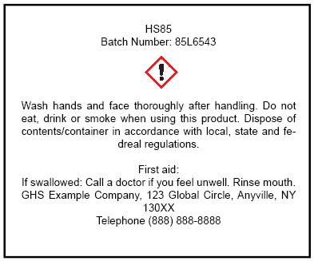
Label Requirements
All Hazardous chemicals intended for use in the workplace must have an OSHA Hazcom 2012 label unless:
    Purchased before June 1, 2015
    Exempt
      Pesticides
      Consumer Products
      Drugs
      Food and Food Additives
      Cosmetics
Notes:
All chemicals that are designed primarily for use in the workplace are required to have a new OSHA label. The OSHA label has specific elements that must be included in order for a label to be compliant.
However, the OSHA Standard has exemptions for chemicals that require labeling under another law. These exemptions include pesticides, consumer products, drugs, food, food additives and cosmetics.
Even when these products are used in the workplace they will have labels as required under those other regulations and not an OSHA label. These products can be used in the workplace without re-labeling as long as an SDS is still obtained.
OSHA HazCom 2012 compliant SDS are required if these exempt products are used in the workplace. The SDS may have additional hazard information that is not on the label. You should read the SDS to be aware of those hazards before using a product.
Products purchased before the effective date of the OSHA Standard (June 1, 2015) do not have to be re-labeled to include the updated formatting.

Slide 12
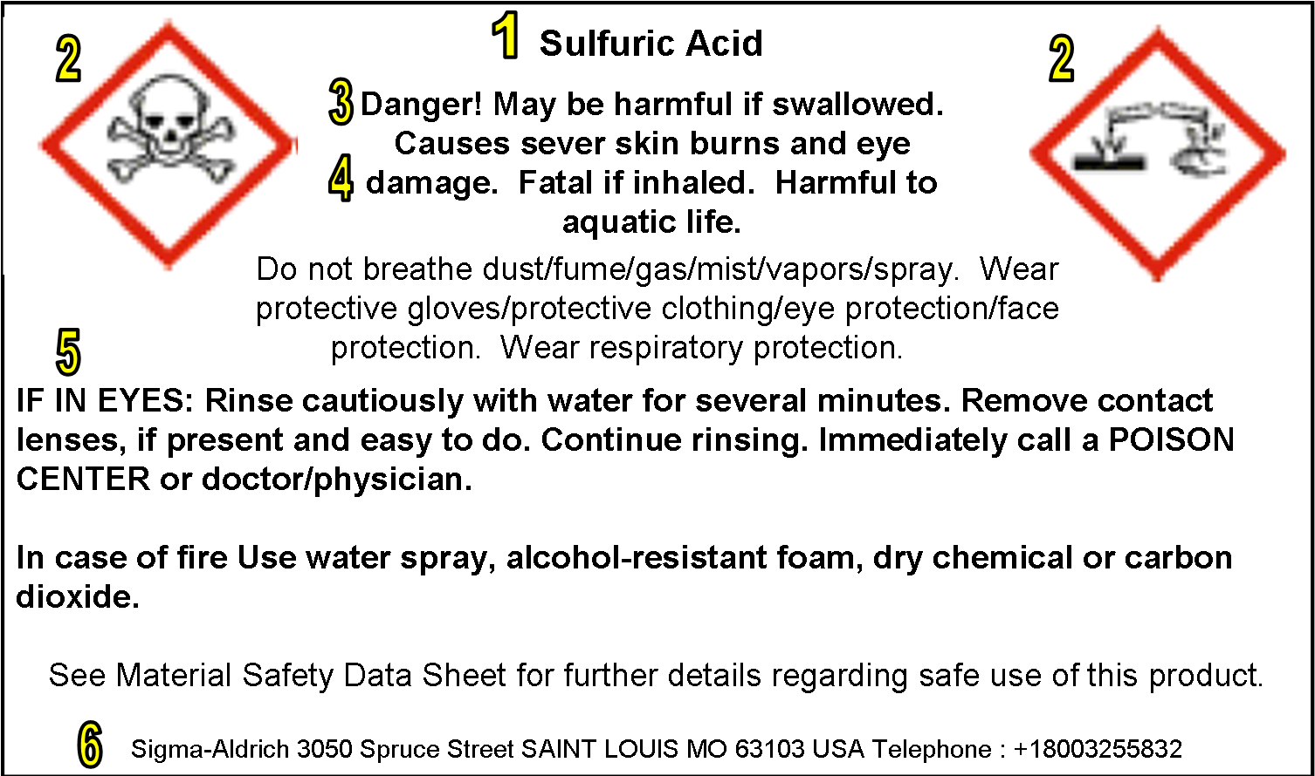
Hazcom 2012 Label
Notes:
As mentioned in the last slide, the new OSHA compliant labels are required to contain specific information that will help an employee identify and understand hazards at a glance.
Let’s use this example label of sulfuric acid to identify the new GHS labeling elements that are required under HazCom 2012. We will then use the next few slides to go into more detail about what these elements represent.
Number 1 displays the product identifier
Number 2 displays the pictograms, multiple pictograms may be displayed on a label if a chemical presents more than one hazard.
Number 3 displays the signal word
Number 4 displays the hazard statements,
Number 5 displays the precautionary statements,
Number 6 displays the supplier’s contact information, this a requirement that has not changed under the revised HazCom standard.

Slide 13
Product Identifier
How the hazardous chemical is identified. This can be (but is not limited to) the chemical name, code number or batch number.
The manufacturer, importer or distributor can decide the appropriate product identifier
The same product identifier must be both on the label and in section 1 of the SDS
Notes:
The Product Identifier is how the hazardous chemical is identified by the manufacturer, importer or distributor. This can be (but is not limited to) the chemical name, code number or batch number. The same product identifier must be both on the label, and in section 1 of the SDS and on the list of hazardous chemicals.

Slide 14
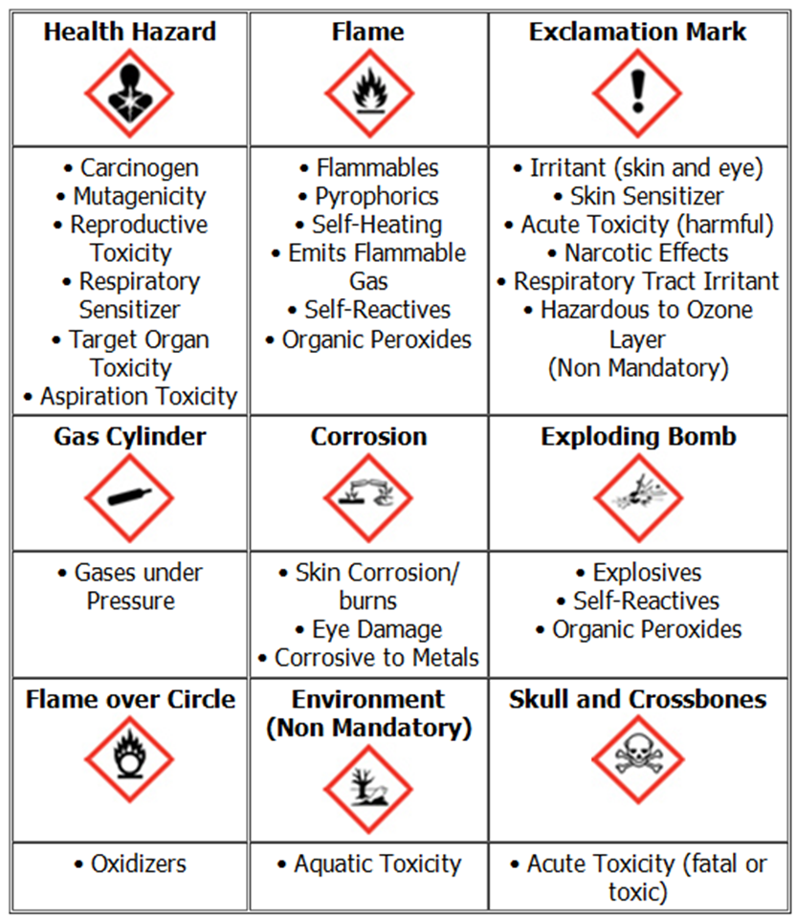
HazCom 2012 Pictograms
Notes:
Nine pictograms, each denoting a different type of hazard have been adopted by OSHA for HazCom 2012. These pictograms appear on product labels which contain ingredients that pose a hazard or multiple hazards to a worker using them.
For example, the Flame pictogram will appear for chemicals that have been classified as ‘flammable’ or ‘Self-Reactive’. An exclamation mark pictogram can appear for a variety of reasons, a few examples include ‘Eye Irritation’, ‘Skin Irritation’ and ‘Respiratory Tract Irritation’.
Because it is the EPA, not OSHA, that regulates environmental hazards, the environmental pictogram is deemed non-mandatory under HazCom 2012.

Slide 15



Signal Words
Used to indicate the relative level of severity of hazard and alert the reader to a potential hazard on the label
There are now only two signal words that are recognized under OSHA’s HazCom 2012.
“Danger” is used for the
more severe hazards
“Warning” is used for
the less severe hazards
Danger
May cause fire or explosion; strong oxidizer
Causes severe skin burns and eye damage
Warning
Harmful if swallowed
Notes:
A signal word is used to indicate the relative level of severity of hazard and alert the reader to a potential hazard on the label. There are now only two signal words
“Danger” is used for the more severe hazards such as “CAUSES SEVERE SKIN BURNS AND EYE DAMAGE “
“Warning” is used for the less severe hazards such as “HARMFUL IF SWALLOWED”
“Caution” is not used as a signal word in the HazCom 2012 Standard. You may still see ‘Caution’ as a signal word on products labeled as consumer products.

Slide 16

Hazard Statements
A statement assigned to a hazard class and category that describes the nature of the hazard(s) of a chemical, including, where appropriate, the degree of hazard.
All of the applicable hazard statements must appear on the label
Hazard statements are specific to the classification categories
Example:
Flammable Liquid
Category 1: Extremely flammable liquid and vapor
Category 2: Highly flammable liquid and vapor
Category 3: Flammable liquid and vapor
Category 4: Combustible liquid
Notes:
Hazard statements describe the nature of the hazard(s) of a chemical, including, where appropriate, the degree of hazard that must appear on the label.
Two examples are “Causes damage to kidneys through prolonged or repeated exposure when absorbed through the skin” and “highly flammable liquid and vapor.”
As you can see on this slide, the severity of the hazard statement depends on the classification of the material. In this example for a flammable liquid, the highest level classification is a category 1. This would show the hazard statement “Extremely flammable liquid and vapor”. For a category 4 classification, there is a less severe hazard and it would prompt the hazard statement “Combustible liquid”.

Slide 17
Precautionary Statements
A phrase that describes recommended measures to be taken to minimize or prevent adverse effects resulting from exposure to a hazardous chemical, or improper storage or handling of a hazardous chemical
Examples of Precautionary Phrases:
Keep away from heat, sparks, and open flame. No smoking.
Wash hands thoroughly after handling.
Wear protective gloves and eye protection.
Store in a well-ventilated place. Keep cool.
Notes:
A Precautionary Statement is a phrase that describes recommended measures to be taken to minimize or prevent adverse effects resulting from exposure to a hazardous chemical. Precautionary statements will be the same on the label and the SDS.
OSHA has adopted four categories of precautionary statements. These include prevention, response, storage and disposal.
A few examples of precautionary statements that you could see include: “Keep away from heat, sparks and open flame. No smoking”, “Wash hands thoroughly after handling”, “Wear protective gloves and eye protection.” and “Store in a well-ventilated place. Keep cool.”

Slide 18
Workplace Labeling
All chemical containers must be labeled.
Do not use a chemical if a label has been destroyed or defaced.
Some chemicals are broken down into smaller containers. Any small container must have a label to protect yourself and your coworkers.
Notes:
Regardless of whether an employer decides to use a HazCom 2012 compliant label or an OSHA approved workplace label, ALL chemicals must have a label that has not been defaced or destroyed. Never use a chemical that does not have a label. If you run into an unlabeled chemical, notify a supervisor immediately.
OSHA requires that all secondary containers be labeled to protect yourselves and your coworkers. This means if you are transferring a chemical from a bulk container to a smaller container, that smaller container must be labeled with the necessary HazCom 2012 elements or with a system created by your employer that provides the same level of understanding of the hazards associated with that product.

Slide 19
Training
Employees must receive information and training regarding:
  The requirements of HazCom 2012
  Locations where hazardous chemicals are present
  HazCom 2012 compliant Safety Data Sheets
  HazCom 2012 compliant Labels
  The school’s Written HazCom Program
  Information on the hazards of the specific chemicals used in our school.
Notes:
Employees must be trained to identify and work safely with hazardous materials in your school.
The HazCom Standard requires that employers provide each person who works with hazardous chemicals with effective training at the time of their initial assignment, and whenever a new chemical hazard is introduced into their work area.
Employee training must be provided on HazCom requirements to include:
- Places where hazardous chemicals are located in the school;
- Operations involving the use of hazardous chemicals;
- The location and availability of the school’s safety data sheets and written program, including their list of hazardous chemicals
- How to understand HazCom 2012 compliant 16-section safety data sheets and labels;
- Information on hazards of specific chemicals used in the school; and
- Proper methods of protection when working with specific chemicals.

Slide 20
Written HazCom Program
Informs employees of their employer’s plan for complying with HazCom 2012.
  Safety Data Sheets
  Labels
  Training Requirements
The Written HazCom Program should always be available by request.
Should include a list of hazardous materials known to be present in the school.
Notes:
A school must document their plan for meeting all the requirements discussed up to this point by creating a Written HazCom Program.
The written program should provide information such as a how labels and other forms of warning, safety data sheets, and employee training requirements will be met.
Tell employees where the written HazCom program is located at your school. They should have access to review this written program at any time.
Employers are also responsible for collecting chemical hazard information from upstream suppliers. The written program must also include a list of hazardous chemicals known to be present in the workplace. The list can be kept by department or the school as a whole. Give examples where hazardous chemicals may be found – i.e. labs, maintenance, sports areas (swimming pool), nurse’s office, art department, …

Slide 21
Protecting Yourself
Wear proper PPE (personal protective equipment) as recommended on the label and/or SDS when using chemicals
Always wash your hands thoroughly after using a chemical
Locate nearest eyewash station or emergency shower before handling chemicals
Work with your supervisor to properly dispose of hazardous materials
Know your company’s spill procedures and emergency response plan
Notes:
The purpose of HazCom 2012 is to provide employees with the proper education to be able to safely handle chemicals in the workplace. To enhance this education, it is also important to keep the following things in mind when using chemicals:
• Always wear proper PPE
• Wash your hands thoroughly after using a chemical
• Always know where your closest eyewash station and emergency showers are located
• Dispose of chemicals properly
• Review your company’s policies for handling spills as well as their emergency response plan.

Slide 22
For More Information
OSHA Webpages www.osha.gov
  Hazcom https://www.osha.gov/dsg/hazcom/index.html
  Personal Protective Equipment https://www.osha.gov/SLTC/personalprotectiveequipment/index.html
  Chemical Hazards https://www.osha.gov/SLTC/hazardoustoxicsubstances/index.html
The Society for Chemical Hazard Communication (SCHC) in alliance with OSHA has developed information sheets on the GHS and Hazcom 2012 https://www.osha.gov/dcsp/alliances/schc/schc.html#!5B
The Consumer Product Safety Commission regulates consumer chemical labeling http://www.cpsc.gov/
The EPA regulates pesticide labeling https://www.epa.gov/science-and-technology/pesticides-science

Slide 23
Thank you
Additional Questions Contact:
OSHA: 1-800-321-OSHA (6742)
Kimball Midwest Quality Assurance Ext: 2590
Notes:
Thank you.

